Slide 1
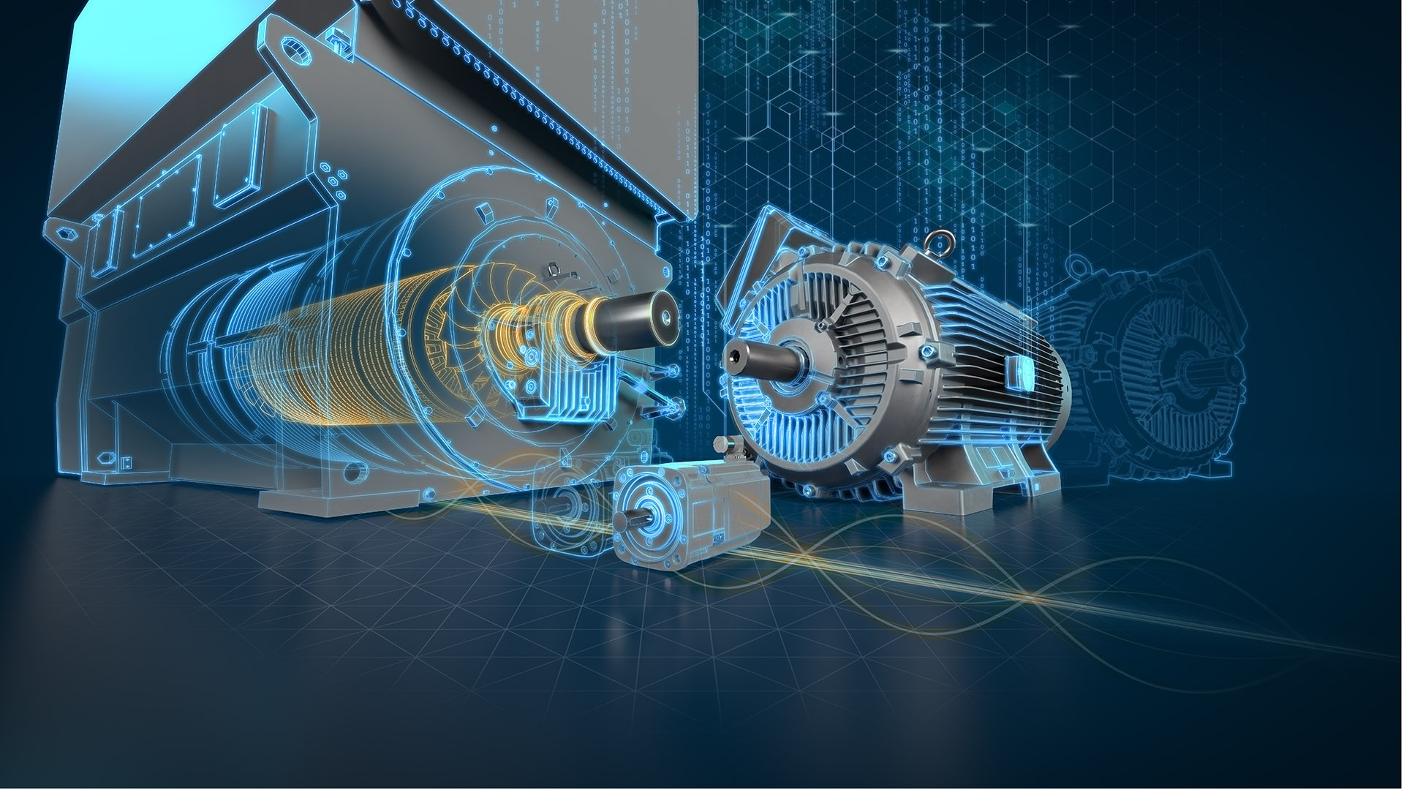
3 phase Squirrel Cage Induction Motor Rewinding
Prepared By:
1906152, 1906153, 1906154, 1906155, 1906156, 1906157

Slide 2

Overview
Introduction of the project
Construction of an induction motor
Disassembling the motor into parts
Reconstructing the motor
Performing tests on the new motor

Slide 3

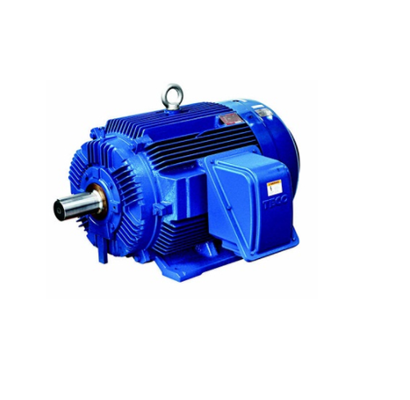
What is Induction Motor
An induction motor or asynchronous motor is an AC electric motor in which the electric current in the rotor is obtained by electromagnetic induction from the magnetic field of the stator winding. The current produces a torque.
In our project, We will rewind a Squirrel Cage Induction Motor whose rated power is 325W

Slide 4
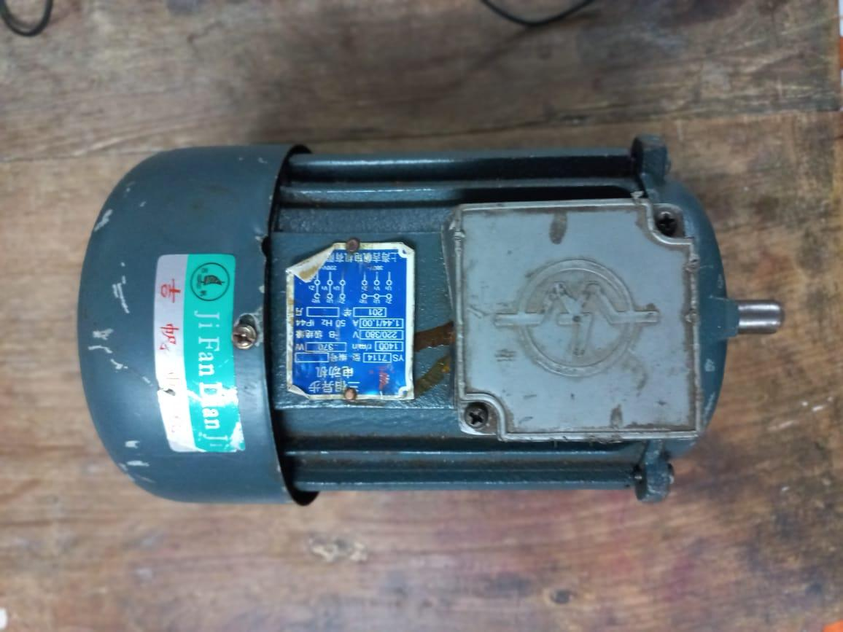
Motor Specification(Rating)
Poles : 4
Horse Power : 0.5
Voltage Rating : 220-380 V
Current Rating : 1.0 – 1.44A
Speed : 1400 rpm

Slide 5
Disassembling of The motor
Three main disassembling parts are:
Solid parts
Copper Wire
Rotors

Slide 6

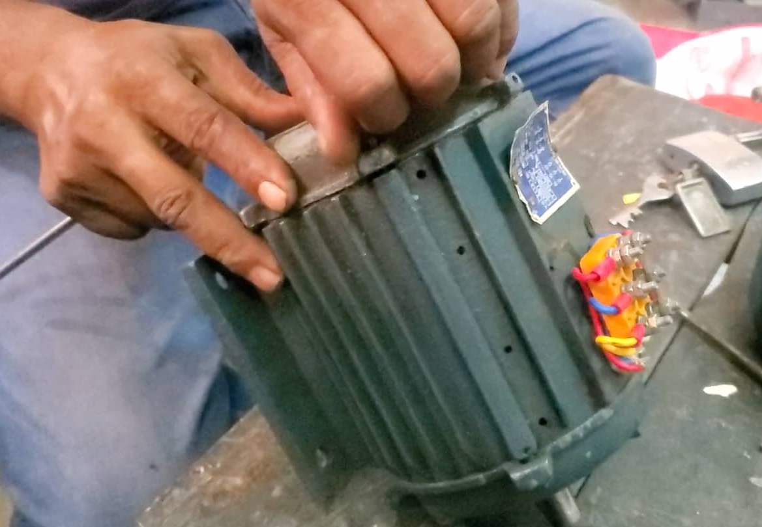
Disassembling of The motor(Solid parts)

Slide 7
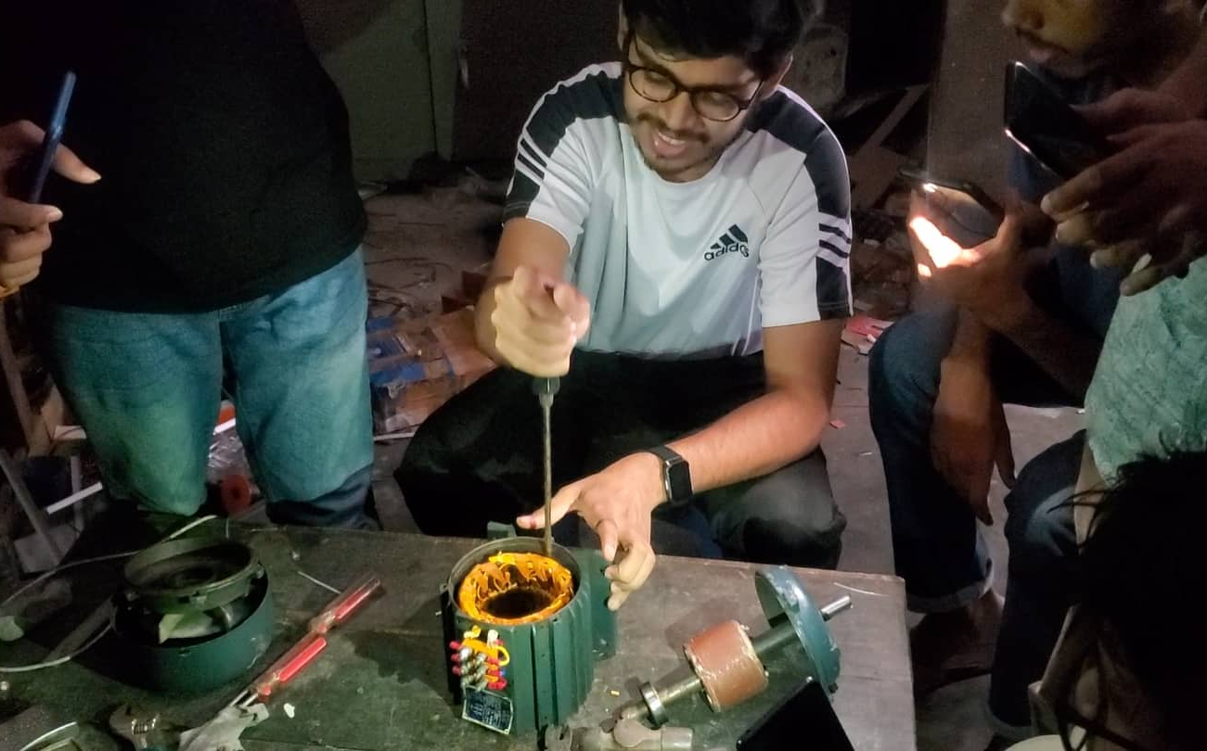
Disassembling of The motor(Copper Wire)

Slide 8
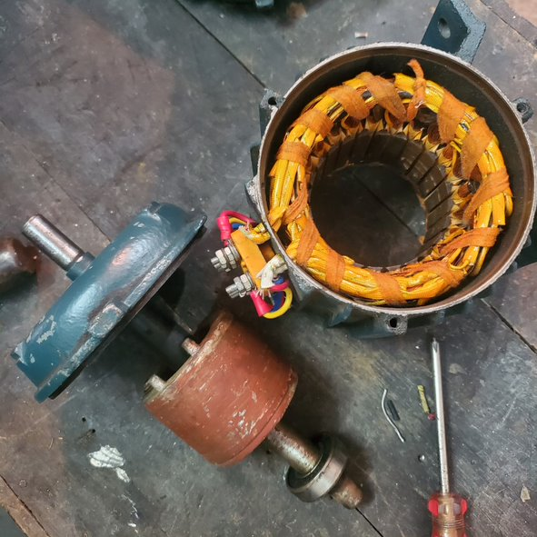
Disassembling of The motor(Rotor)

Slide 9
Wire Specification
Wire type: 100% copper
Turns per slot: 156
Wire gauge Measured: 28 Bought: 28

Slide 10
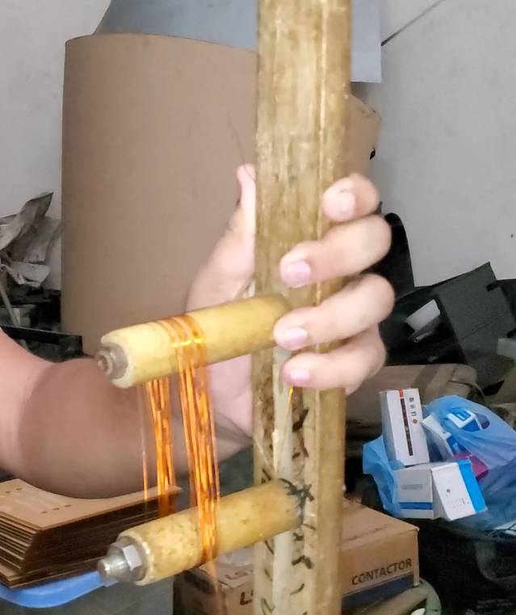
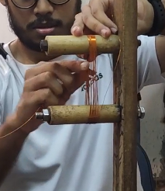
Reconstruction of the Coils/Windings

Slide 11


Coil Placement and Connections
B
B
A
A
1 2 3 4 5 6 7 8 9 10 11 12 13 14 15 16 17 18 19 20 21 22 23 24

Slide 12
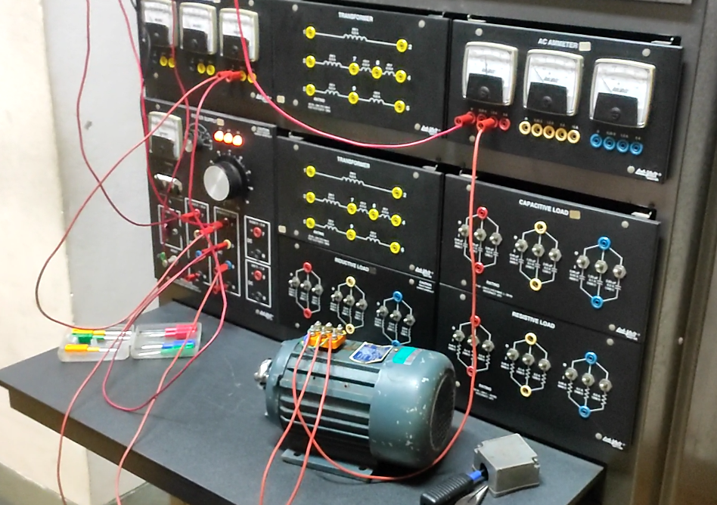
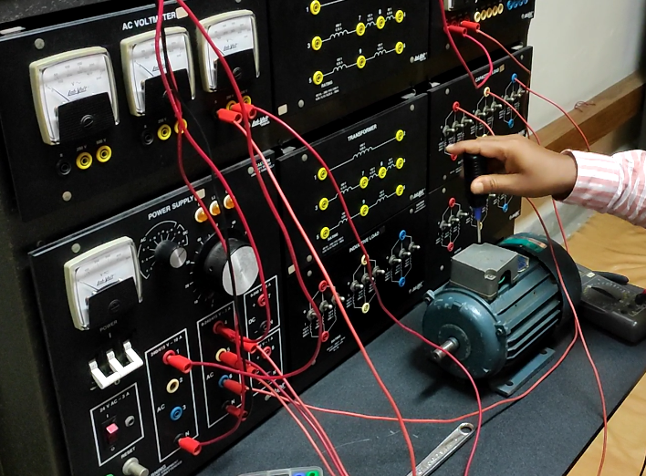
Laboratory Test

Slide 13
Laboratory Test Data
No Load Test
Blocked Rotor Test
DC Test
Test Parameters | Values
Voltage | 345 Volts
Current | 0.45 A
Power(Per-phase) | 11 watts
Test Parameters | Values
Voltage | 120 Volts
Current | 0.7 A
Power(Per-phase) | 39 watts
Test Parameters | Values
Coil 1 | 43.7 Ω
Coil 2 | 42.6 Ω
Coil 3 | 42. 9 Ω

Slide 14
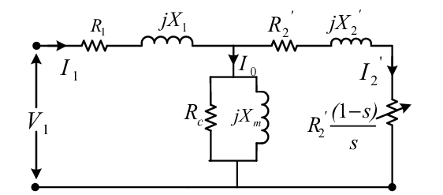
Equivalent Circuit Calculation
Equivalent Circuit Parameters
Parameters | Values
R1 | 43.067 Ω
R2 | 36.533 Ω
X1 | 23.332 Ω
X2 | 35.298 Ω
Xm | 407.337 Ω
Fig -1: Three phase Induction Motor Equivalent circuit referred to the Stator Side
Figure Courtesy : https://www.semanticscholar.org/paper/Estimation-of-equivalent-circuit-parameters-of-and-Bhowmick-Manna/2da074f423efe631c88c21926be3510c04d618a7/figure/0

Slide 15
Cost Calculation
Costing of this Project
Instruments | Cost(BDT)
Motor | 1200
Insulated Copper Wire | 900
Varnish | 40
Fibre | 90
Miscellaneous | 100
Total | 2330

Slide 16
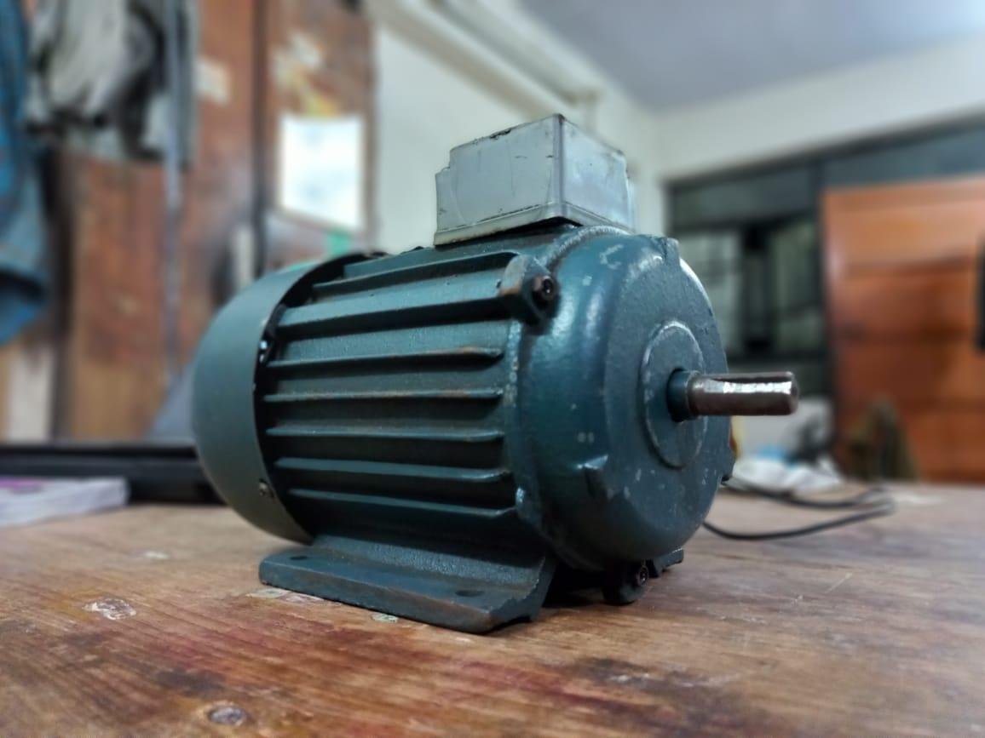
The Reconstructed Motor

Slide 17
Challenges Faced During this Project
Lack of Experience
No Automatic Winding Machine
Equipment Shortage

Slide 18
Thank You

